Slide 1
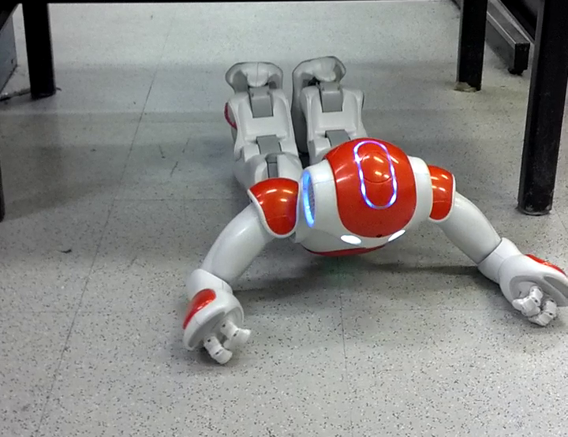

Projected Profile
Humanoid Crawl Gait
And
Lidar Based Navigation
Using GODZILA
Griswald Brooks
Advisor: Dr. Farshad Khorrami
12/22/2016

Slide 2
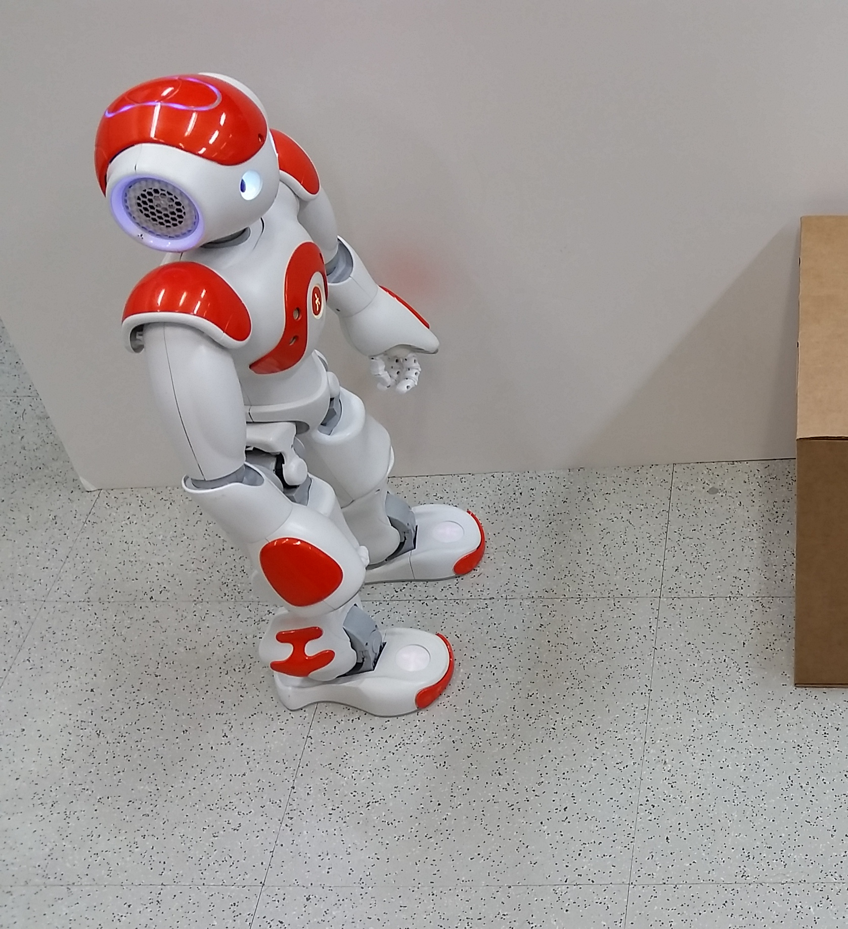
Presentation Outline

Slide 3
Presentation Outline
Introduction
Platform
GODZILA Navigation
Projected Profile Gait
Conclusion
12/21/2016
3

Slide 4
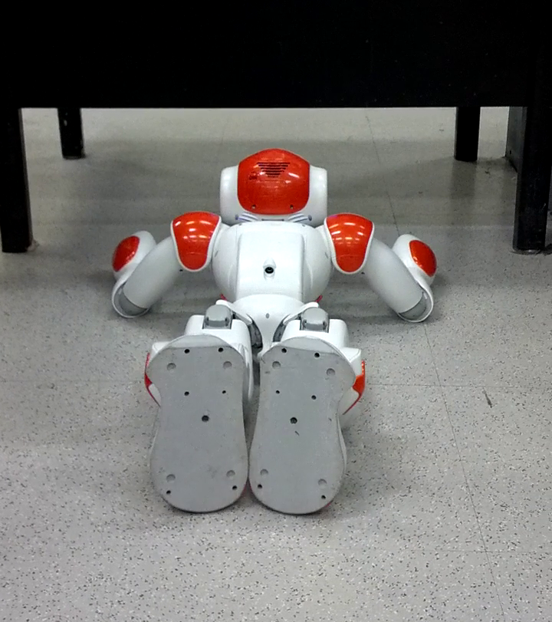
Introduction

Slide 5
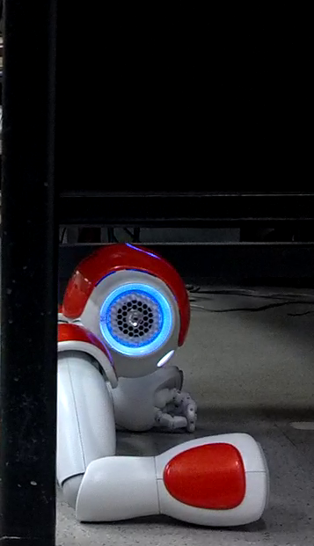
Introduction
Concept and Motivation
Platform Overview
GODZILA Navigation
Projected Profile Gait
12/21/2016
5

Slide 6
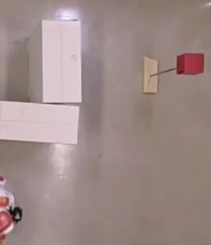
Introduction
GODZILA Navigation
12/21/2016
6

Slide 7
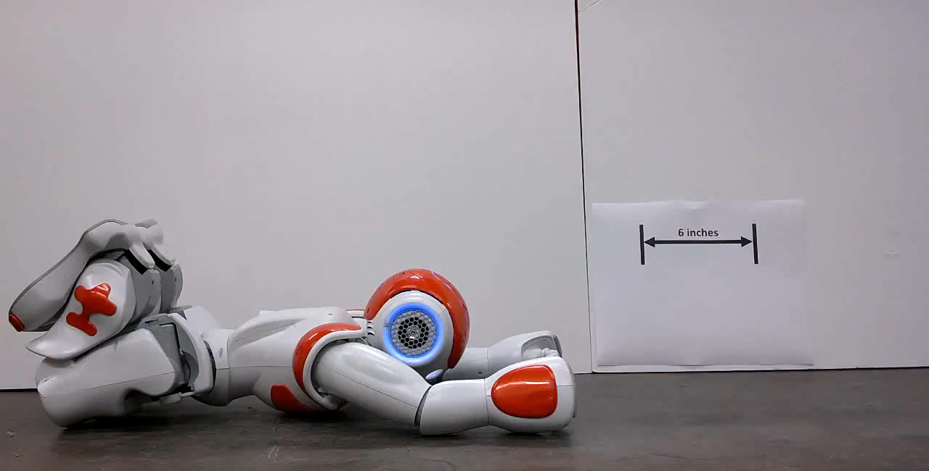
Introduction
Projected Profile
12/21/2016
7

Slide 8
Introduction
12/21/2016
8

Slide 9
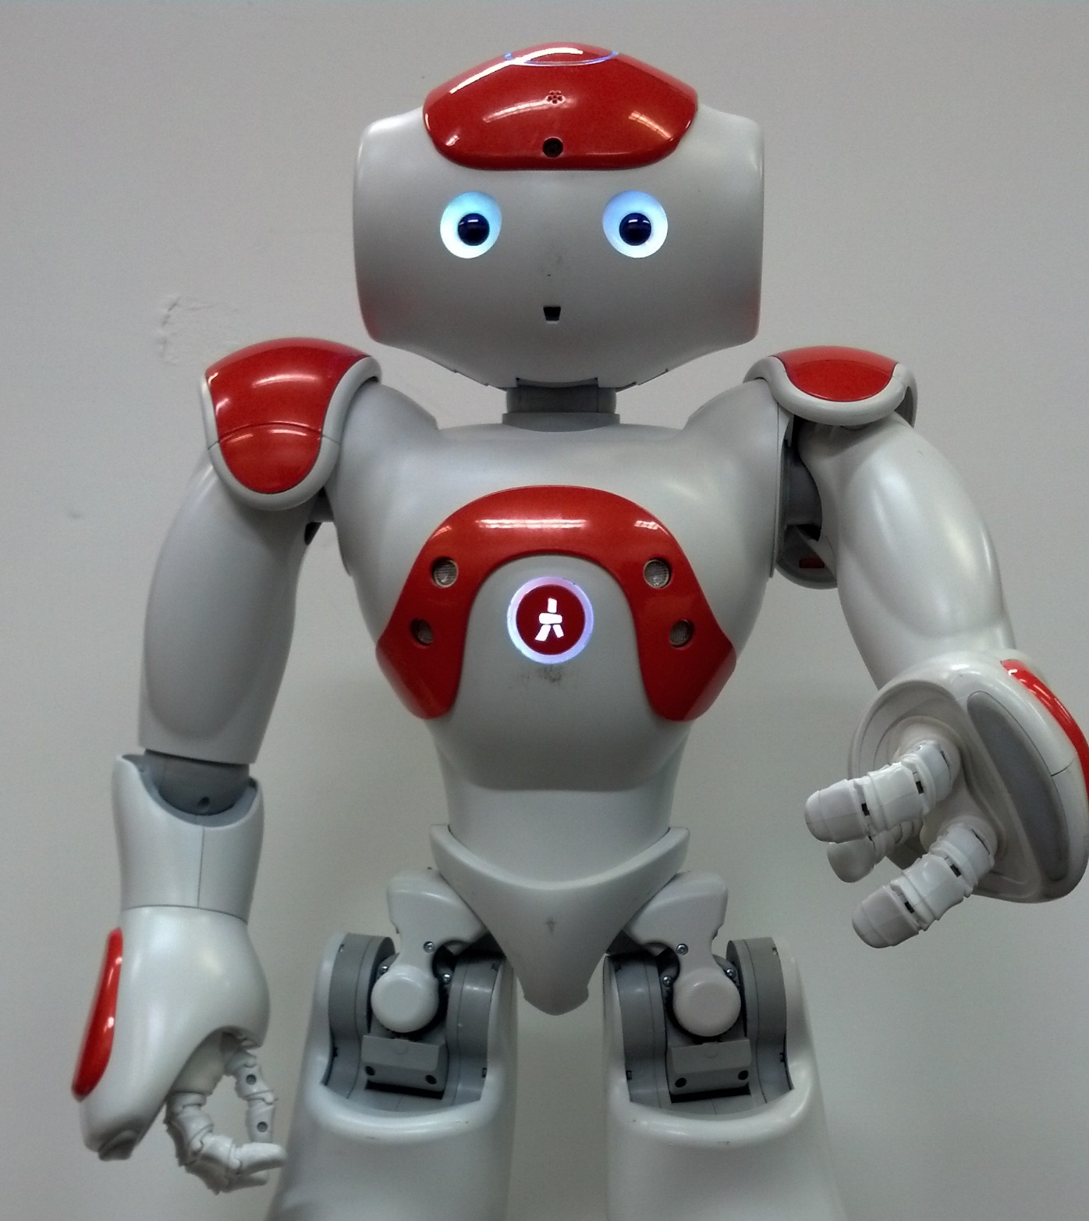
Platform Overview

Slide 10
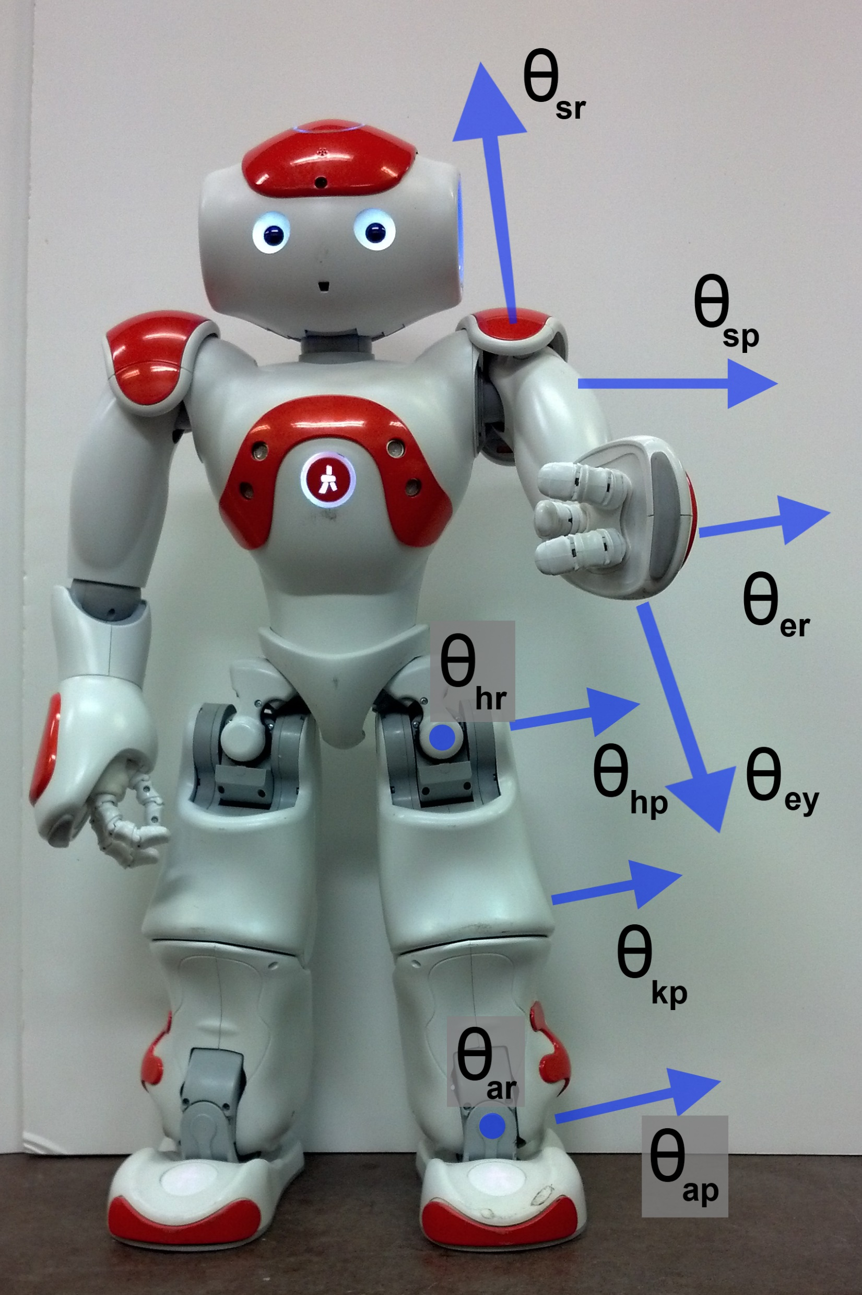
Nao Platform
Aldebaran Robotics
25 DoF humanoid, 58 cm, 4.3 kg
Atom processor, cameras, sonars, IMU
Laterally symmetric, no back joint
12/21/2016
10

Slide 11
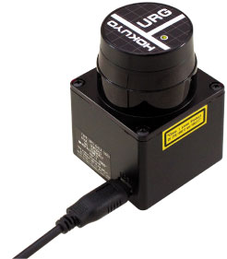
Nao Platform
Lidar
12/21/2016
11

Slide 12
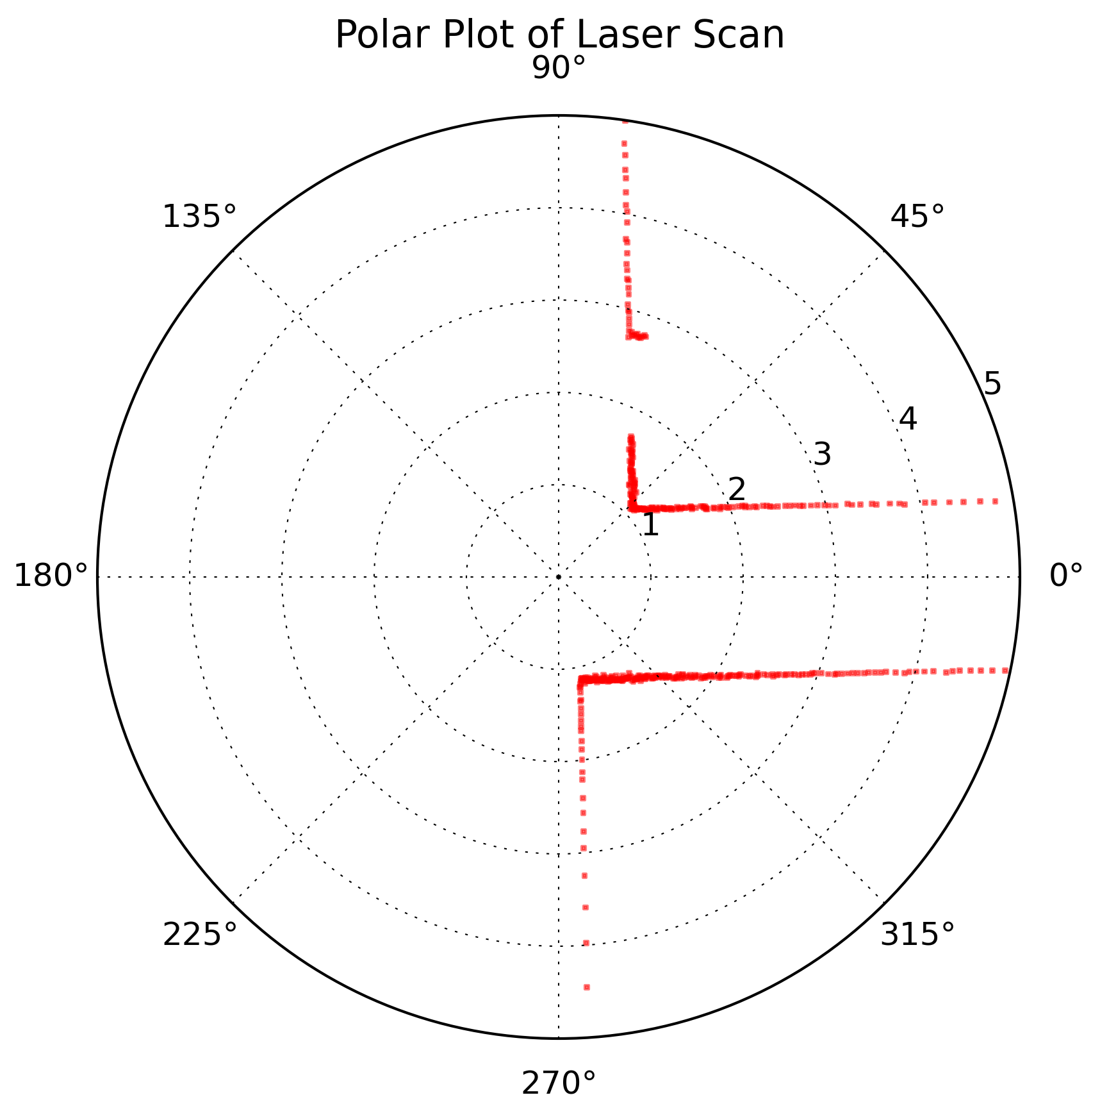
Nao Platform
Lidar
12/21/2016
12

Slide 13
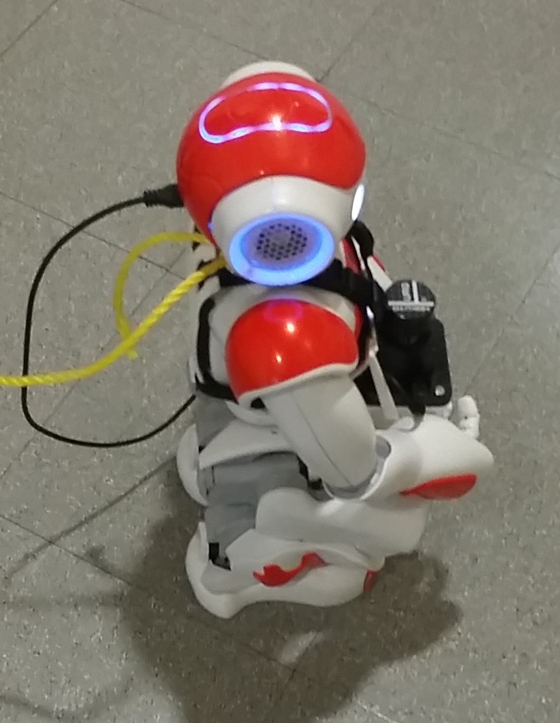
Nao Platform
Mount
12/21/2016
13

Slide 14
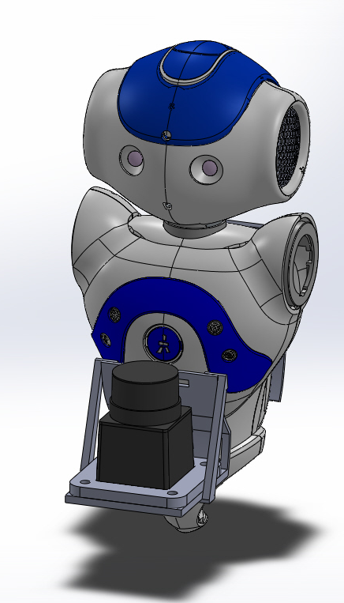
Nao Platform
Mount
12/21/2016
14

Slide 15
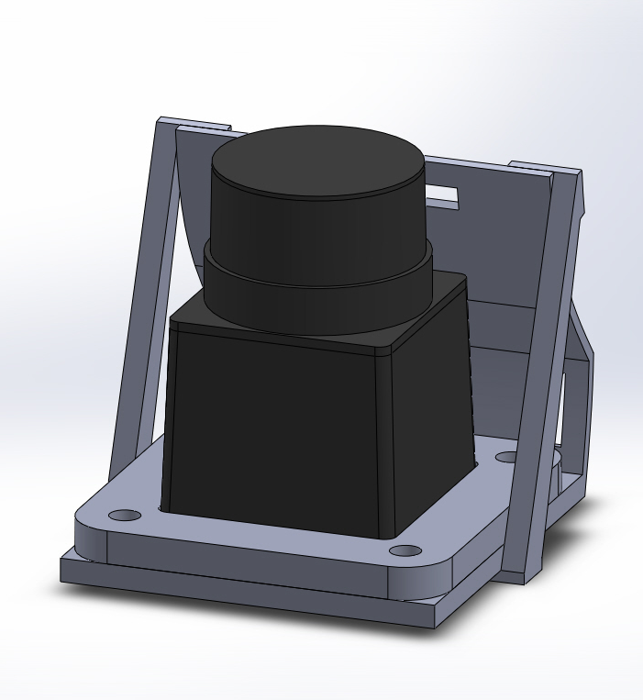
Nao Platform
Mount
12/21/2016
15

Slide 16
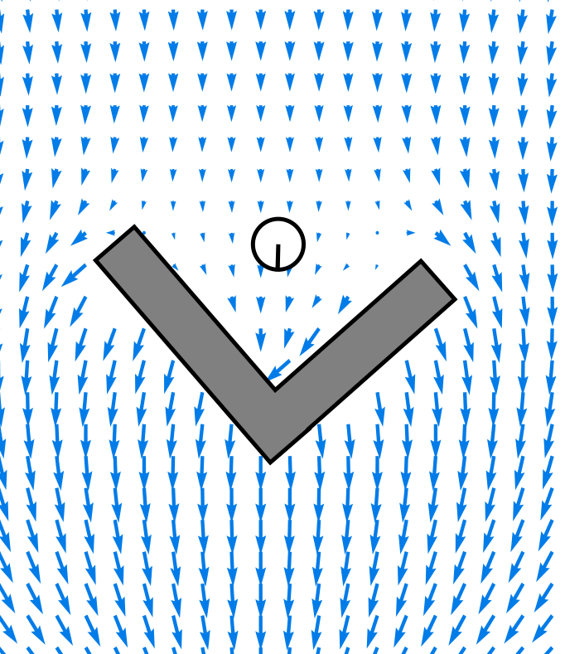
GODZILA
Navigation

Slide 17
GODZILA Navigation: Potential Fields
Potential Field intro
12/21/2016
17

Slide 18
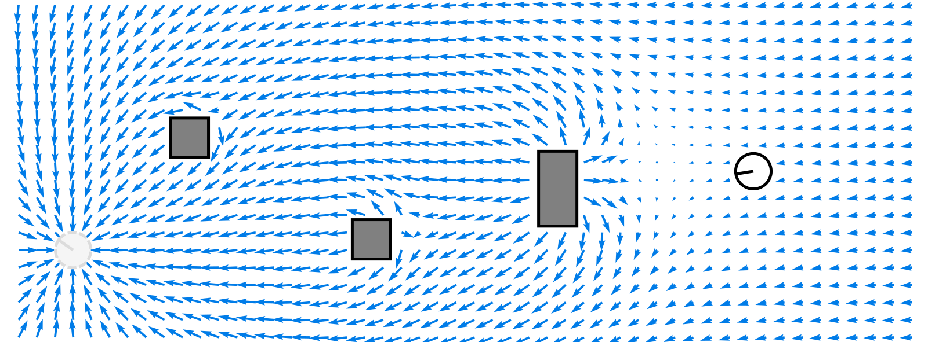
GODZILA Navigation: Potential Fields
12/21/2016
18

Slide 19
GODZILA Navigation: Potential Fields
Potential Field equations
12/21/2016
19

Slide 20
GODZILA Navigation
GODZILA Intro
12/21/2016
20

Slide 21
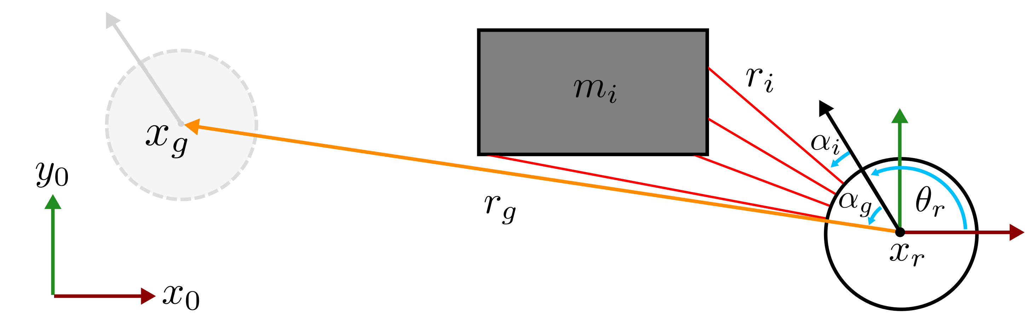
GODZILA Navigation: Parameters
12/21/2016
21

Slide 22
GODZILA Navigation
GODZILA Components
12/21/2016
22

Slide 23
GODZILA Navigation
GODZILA Formulation
12/21/2016
23

Slide 24
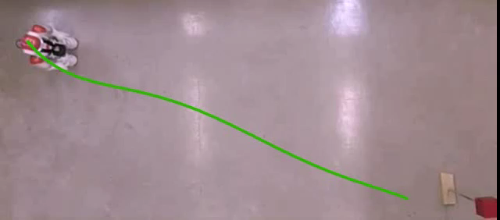
GODZILA Navigation: Open Area
12/21/2016
24

Slide 25
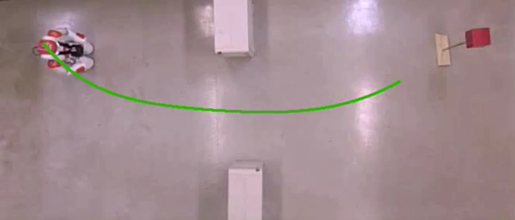
GODZILA Navigation: Narrow Opening
12/21/2016
25

Slide 26
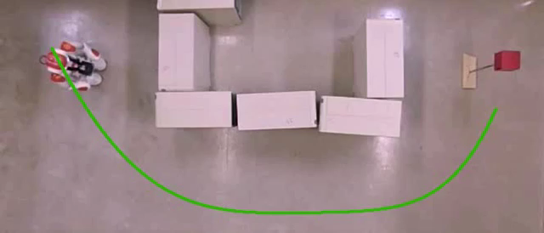
GODZILA Navigation: Square Area
12/21/2016
26

Slide 27
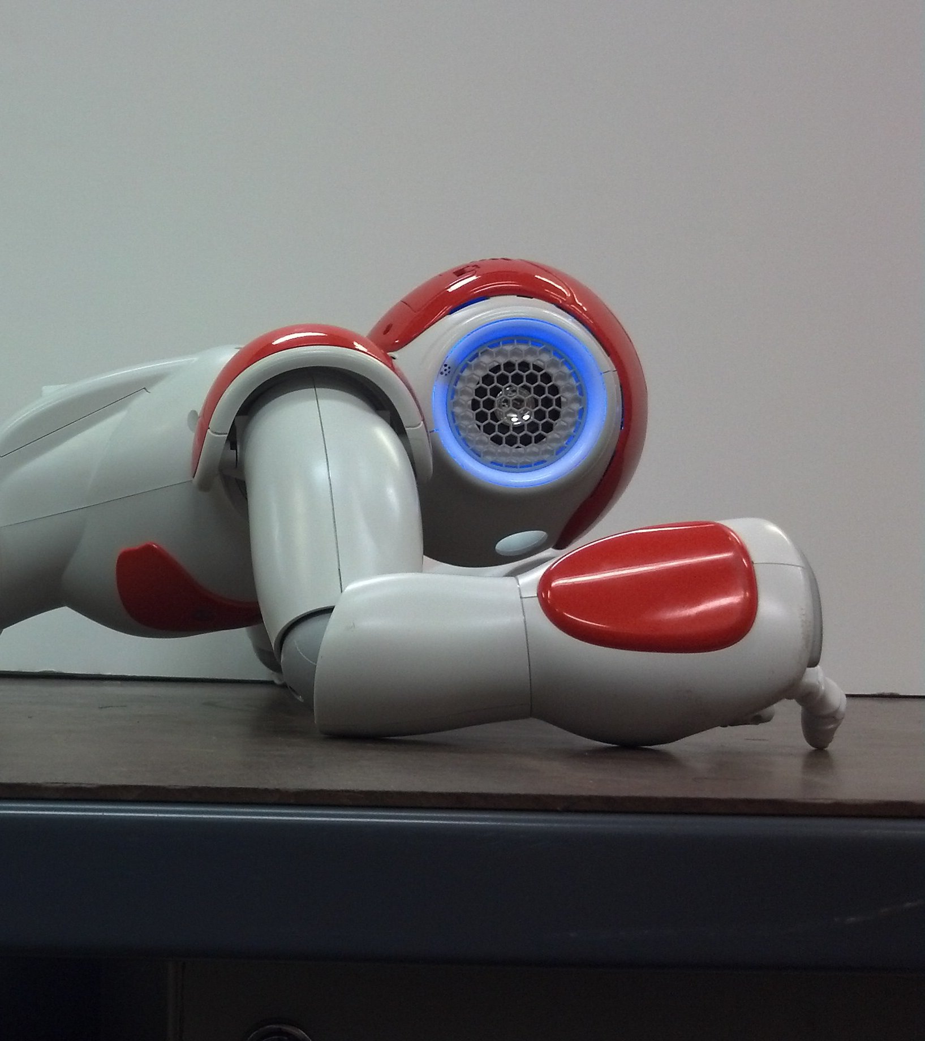
Projected Profile
Gait

Slide 28
Crawl Gait
Projected Profile
Sagittal Plane Projection
25 DoF to 6 DoF
Dual Mode
Open Chain
Move end effectors
Closed Chain
Move CoM
12/21/2016
28

Slide 29
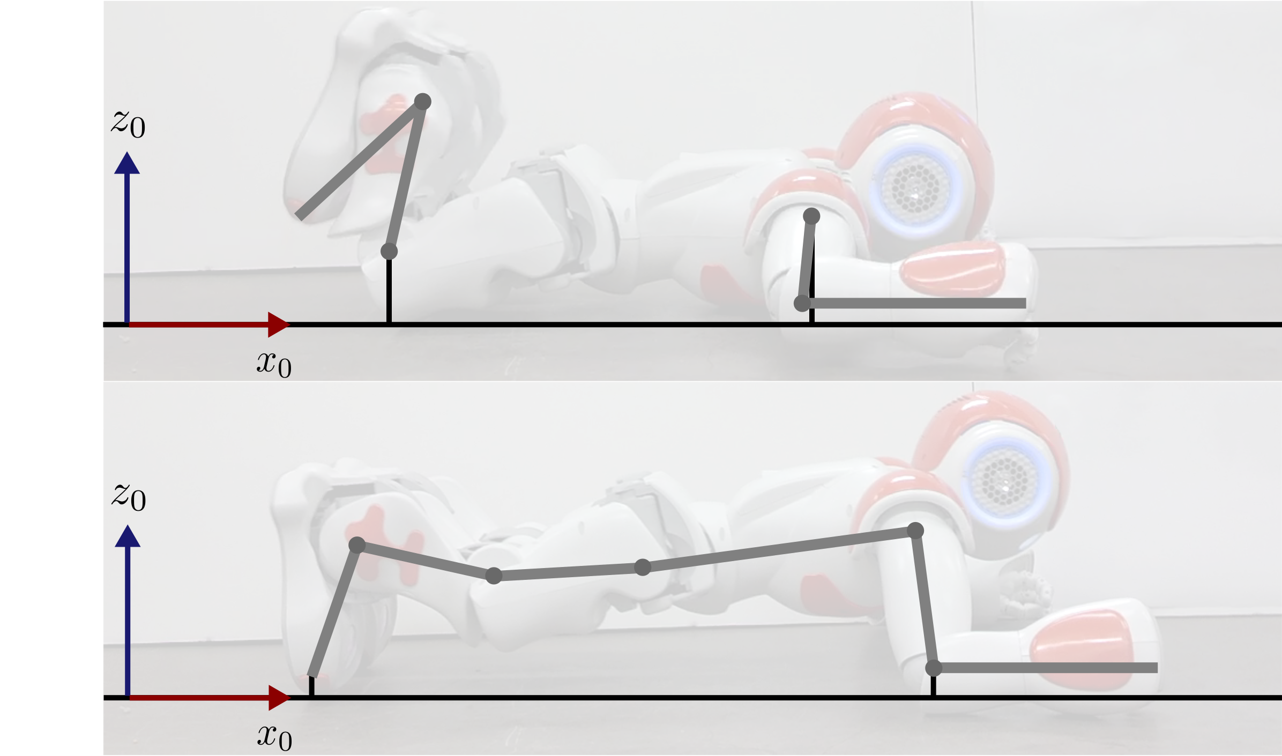
Projected Profile Gait: Concept
Open Chain
Closed Chain
12/21/2016
29

Slide 30
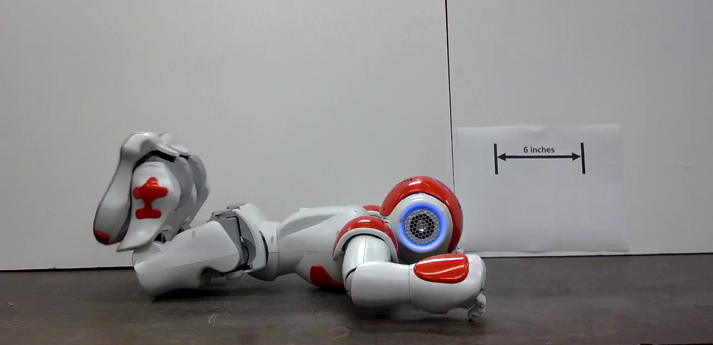
Crawl Gait: Open Chain
Open Chain
Torso on ground
Arms and legs can be positioned
ADD STICK FIGURES
12/21/2016
30

Slide 31
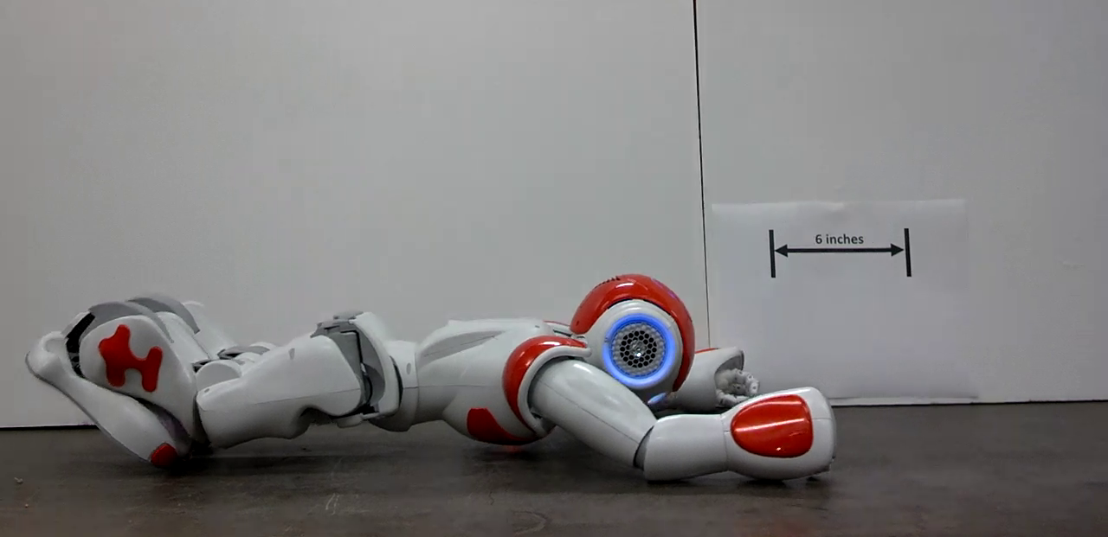
Crawl Gait: Extension
Closed Chain: Extension
Arms and legs on ground
Torso can be positioned
CoM is at initial position
12/21/2016
31

Slide 32
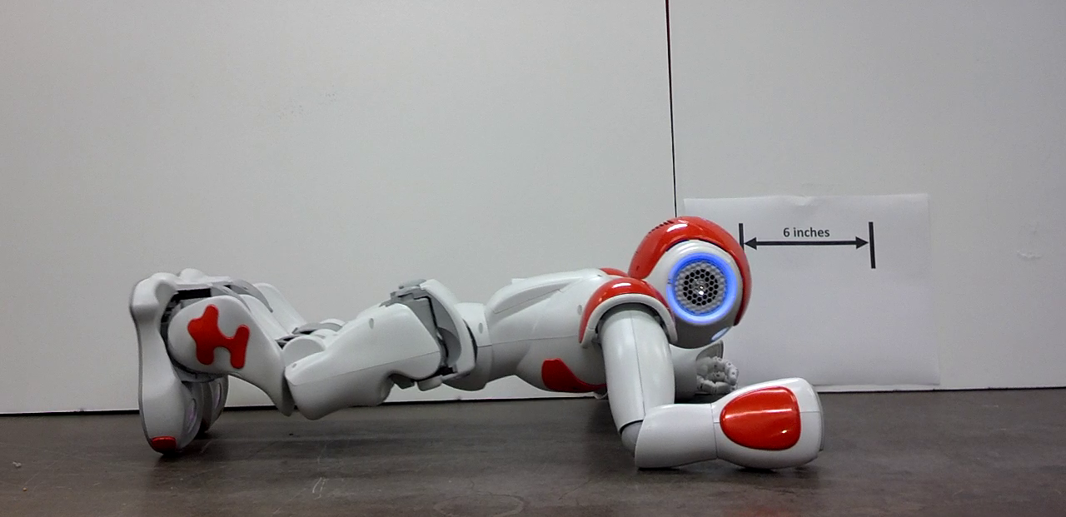
Crawl Gait: Compression
Closed Chain: Compression
CoM is at final position
12/21/2016
32

Slide 33
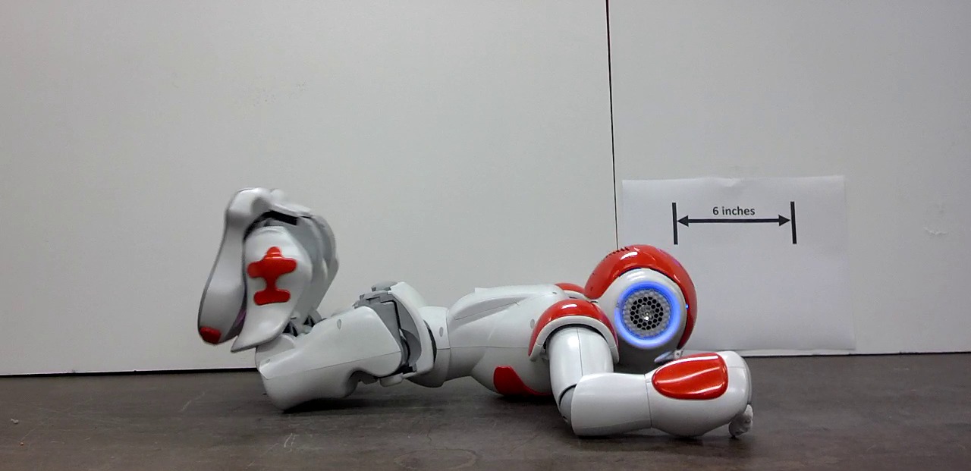
Crawl Gait: Open Chain
Open Chain
Torso on ground
Arms and legs can again be positioned
12/21/2016
33

Slide 34
Crawl Gait: Open Chain
12/21/2016
34

Slide 35
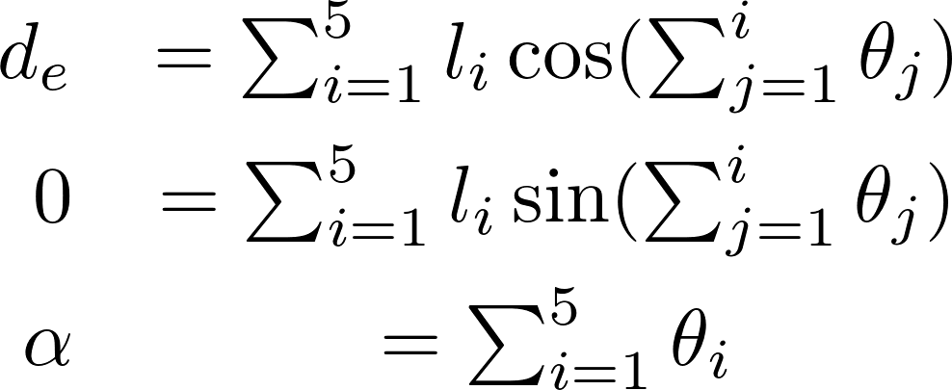
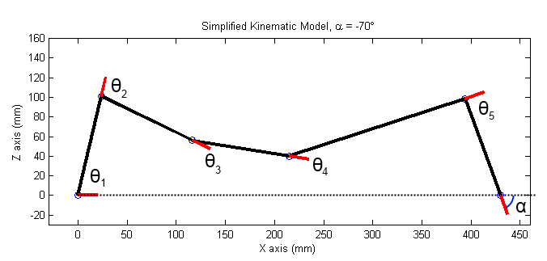
Crawl Gait: Projected Profile
Foot “joint” is not actuated
Knee and Hip as free variables
Remaining joints function of Elbow
12/21/2016
35

Slide 36
Crawl Gait: Ankle Solution
Solving for Ankle Joint
Squared sum
12/21/2016
36

Slide 37
Crawl Gait: Ankle Solution
Solving for Ankle Joint
12/21/2016
37

Slide 38
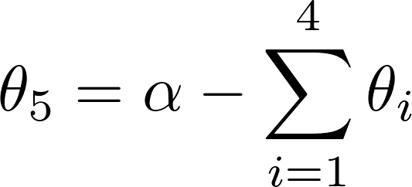
Crawl Gait: Joint Solutions
Yields two solutions for Ankle
One is kinematically infeasible
Foot joint follows from Ankle
Shoulder joint is given by:
12/21/2016
38

Slide 40
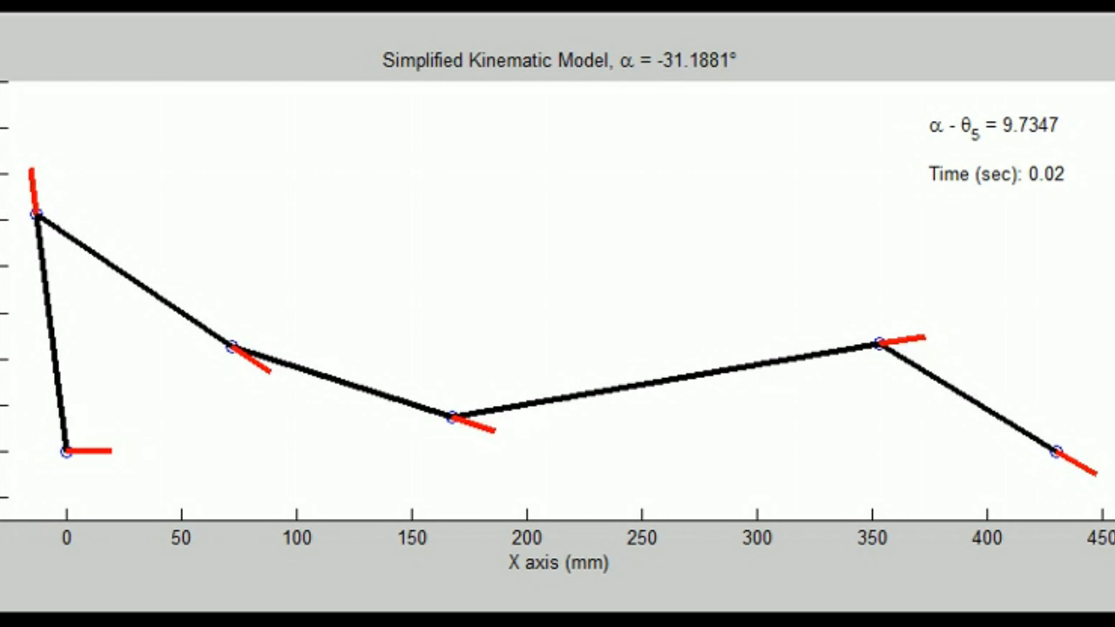
Crawl Gait: Projected Profile
12/21/2016
40

Slide 41
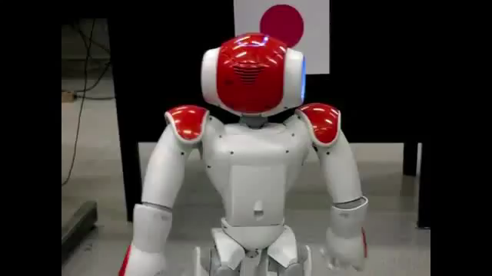
Crawl Gait: Crawl Sequence

Slide 42
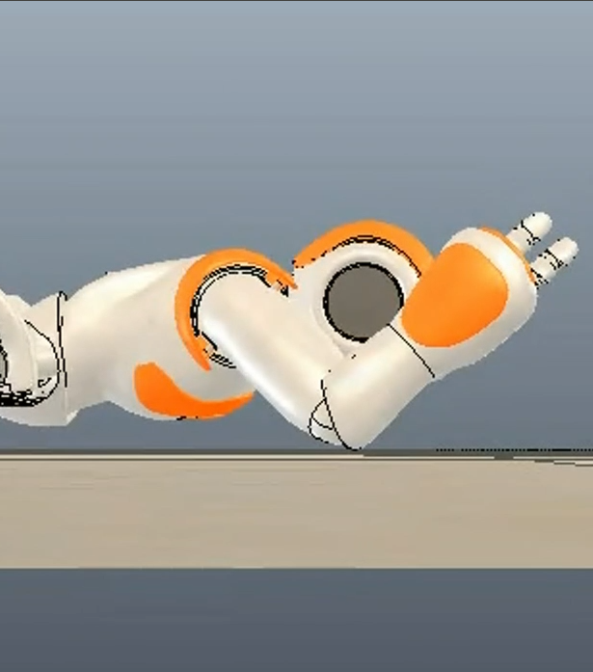
Gait Optimization

Slide 43
Gait Optimization
Knee and hip as free variables
Optimize wrt torques
Pseudo-static formulation
12/21/2016
43

Slide 44
Crawl Gait: Projected Profile
Video of projected profile sticks optimized
12/21/2016
44

Slide 45
Crawl Gait: Projected Profile
Video of simulated optimized
12/21/2016
45

Slide 46
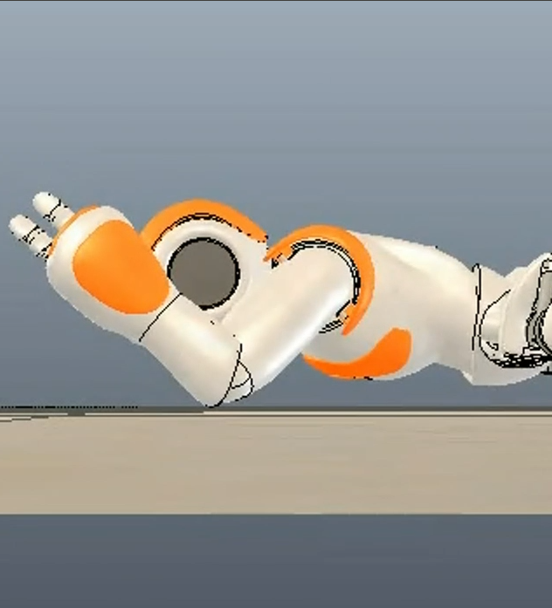
Gait Optimization
V-REP simulation
Table of joint angles to torques
2.5° resolution
± 30° about initial pose
Linear interpolation
Genetic algorithm for optimization
12/21/2016
46

Slide 47
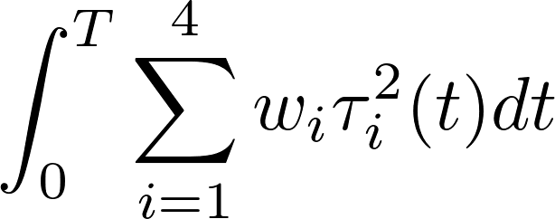
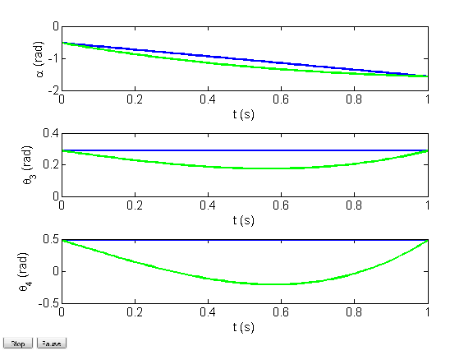
Gait Optimization
Cost Function
Shoulder weighted more to minimize use
Terms to prevent backtracking and use feasible joint range
Cubic splines
ADD INDICATOR FNS
4.6x reduction in cost
12/21/2016
47

Slide 48
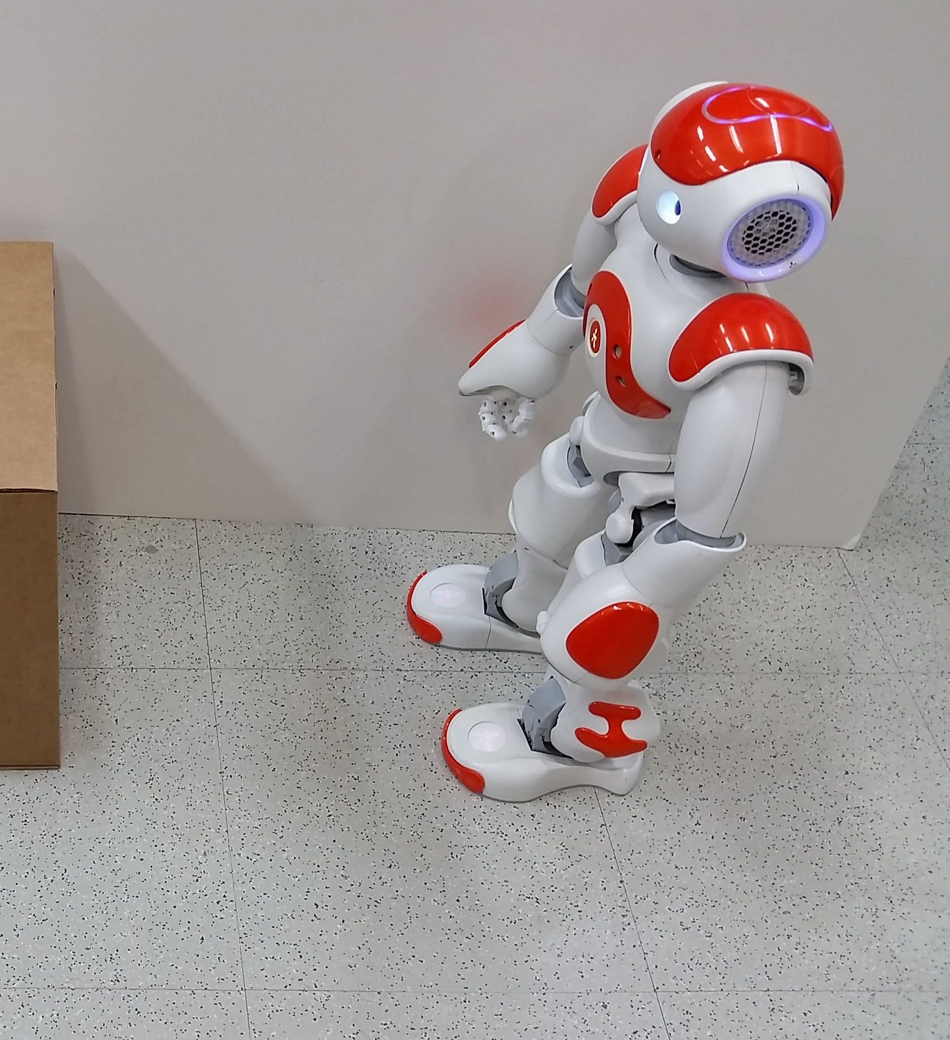
Conclusion

Slide 49
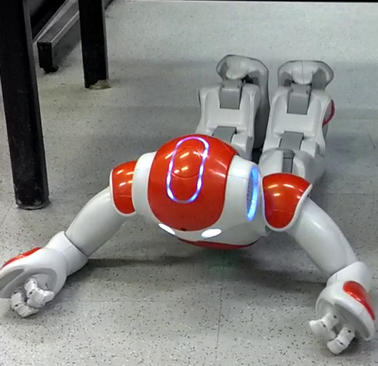
Conclusion
Nao Humanoid
Projected Profile
Optimizing free params
Generality
Heading control
Back orientation control
12/21/2016
49

